Slide 1

Put your stuff online for $2 (fast, flexible & easy to build IoT project using ESP8266 & AWS)
Tim Meyer & John Stamper
timmeyer@ stamperj@ amazon.com

Slide 2







What are you looking at??
Crypto signed
RESTful call
(JSON)
Event
(JSON)
ESP8266
Amazon Lambda
Flow sensors
Amazon SNS
Updates
Simple Web UI
Amazon Elasticache - Redis
Simple Web UI
Node.js on Amazon EC2
users

Slide 3
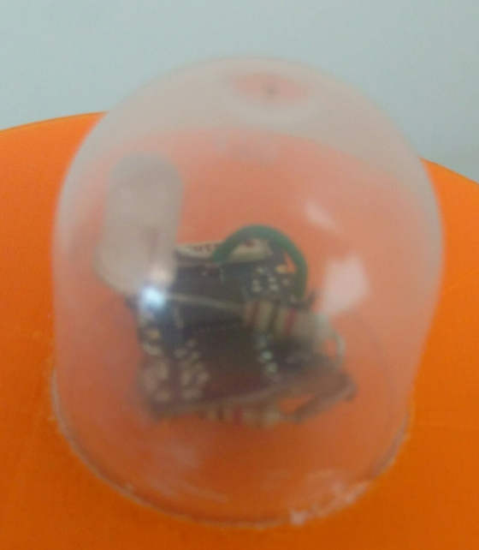
Widget – ESP8266
$2 wifi SoC – wireless client, AP, webserver, Arduino IDE compatible
At boot reads config (wireless, credentials, SNS topic and endpoint) from EEPROM, connects to wifi, dips NTP, waits for beer flow
On flow, posts JSON messages to SNS via secure signed RESTful call to SNS (v4 signature)
If config borks, widget turns into AP and web server, accepts config details, restarts
https://github.com/tim-in-oakton/ESP8266Kegerator

Slide 4


SNS and Lambda
SNS is a pub/sub messaging service
Supports email, SMS, Lambda, SQS, HTTP/HTTPS, Mobile Push
Lambda is event-driven managed stateless compute
Supports 1.5GB memory and 60 seconds of runtime
node.js and Java8

Slide 5


node.js and Elasticache
Node.js is a JavaScript runtime built on Chrome’s V8 Javascript engine
Event-driven, non-blocking I/O model that make it lightweight and efficient
Elasticache is an in-memory caching service
Memcached and Redis

Slide 6
How does it work together??
Pull the tap, impeller pulses trigger ISR on 8266
Widget Posts JSON beer-event to SNS using RESTful signed call (http gett)
Lambda function is subscribed to SNS topic, runs when event is posted – it updates REDIS datastore
Redis maintains state of beer - # pulls, last beer volume, cumulative volume
Node.js server listens on port 80, serves simple page that pulls from Redis
(all services fit in AWS free usage tier)

Slide 7
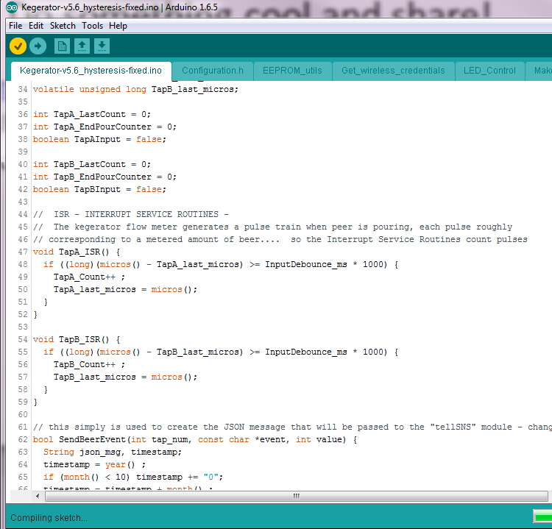
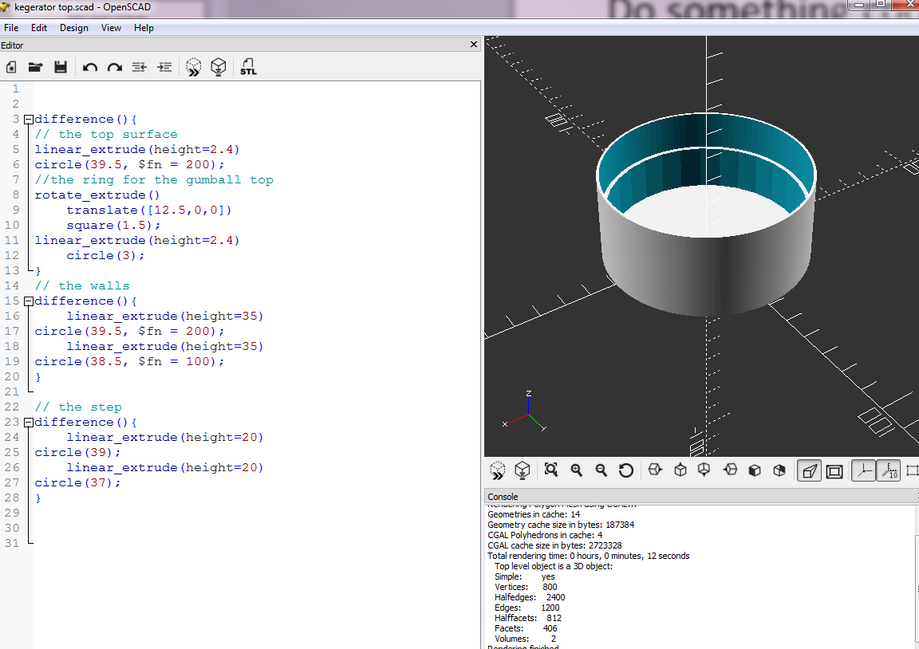
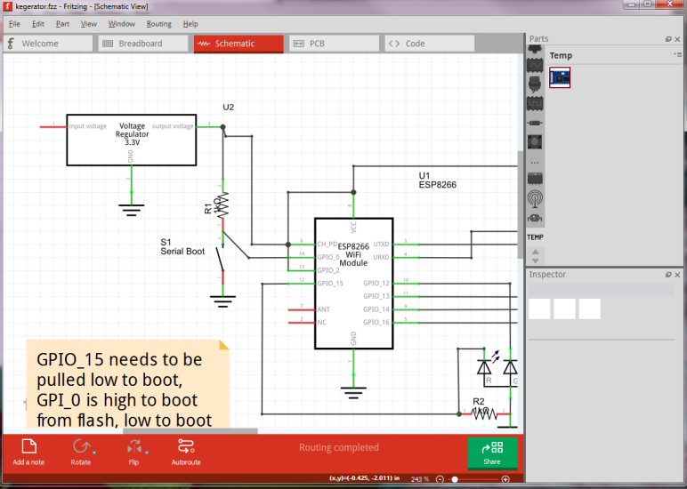
Do something cool and share!
https://github.com/tim-in-oakton/ESP8266Kegerator
All code posted
Schematics, documentation, 3d models

Slide 8
ESP8266 Quick Start (using Arduino IDE)
Super simple get-going guide

Slide 9
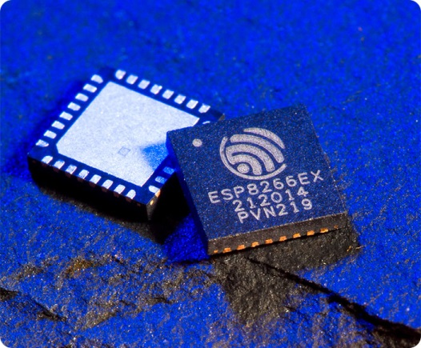
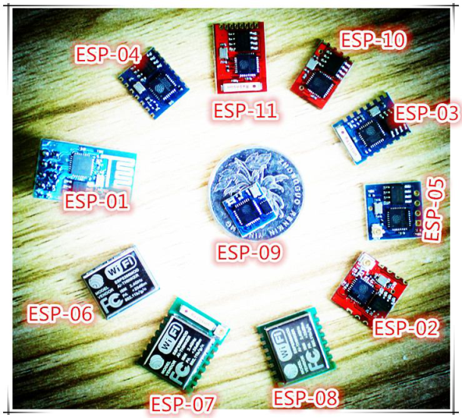
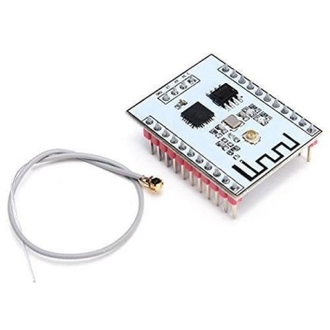
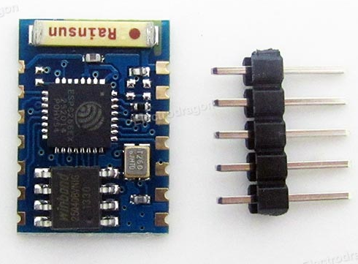
ESPWhat?
ESP8266 = Chip (System-on-Chip from Espressif….. CHEAP, highly integrated micro/wifi/memory system)
Ton of modules using this chip – ESP8266-01 to -12, -201 (all are tiny)
Breakoutboards and piggybacks available
Wifi 802.11bgn(adhoc, client, AP), TCPIP stack, low power modes, 32 bit CPU, integrated w flash & EEPROM
ESP8266-03
512K FLASH
64K inst RAM/96K Data
1K EEPROM
7 GPIO, I2C, UART, Serial
Teeny weeny

Slide 10
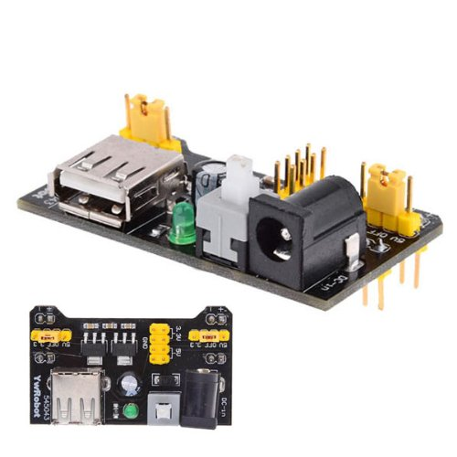
ESPWhat to Know
Tiny Modules are seriously hard to work with – magnify
Prototype big, then debiggafy
All modules are 3.3V, you need a 3.3V FTDI serial thingy
http://www.amazon.com/SparkFun-FTDI-Basic-Breakout-3-3V/dp/B004G52QR0
They can be power pigs when Transmitting
(can pull over 200mA!!)
Three GPIO are spoken for (GPIO 0,2,15) – tricky
(pull 15 low and 2 high to boot, 0 controls flash/serial boot)
Espressif toolchain is not for beginners, use Arduino IDE instead
https://github.com/esp8266/Arduino

Slide 11
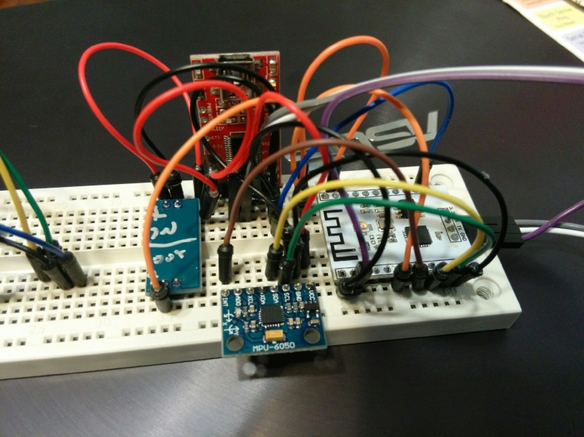
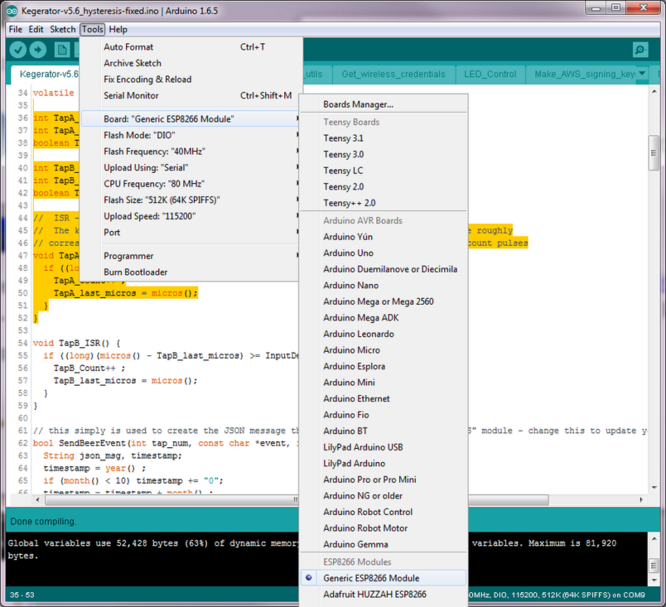
KISS Recipe
Start big & simple –
ESP8266-201/12 + breadboard + Battery PS + FTDI
https://github.com/esp8266/Arduino add ESP8266 to your Arduino IDE in 60 secs. Wonderful
GPIO_15 needs to be pulled low to boot, GPI_0 is high to boot from flash, low to boot from serial (upload code), GPIO_2 needs to be high at boot

Slide 12

ESPWhat to Know – Part 2
There be bugs. Be patient, Google & ask
This is more complex than Blink
No HTTPS/TLS/SSL yet
Web stuff often needs Base64, URI encoding (%20), HMAC/SHA, hex strings(F ≠ 0F)…..
Putty does 78200 bps
Magic smoke is waiting to escape – 5v WILL kill it
A reset a day keeps the migraine away

